Slide 1
Functions are proofs! An introduction to the F* Language
Mark Gritter
@markgritter
MinneBar 2022

Slide 2

Software (still) sucks
Software is hard.
“Try very hard and think a lot” is a failed solution.
Even very smart people miss simple edge cases.
Notes:
Smart people still produce bugs. It’s inevitable. Even when they try to prove that their code is correct, seasoned professionals make mistakes.

Slide 3

Goal: Have the computer check my bullshit
There are lots of things I think are true about my programs.
What if I could tell the computer about them? And have it check if I’m correct?
(And, maybe, use them for optimization?)
Photo by No Revisions on Unsplash

Slide 4
F*: A Proof-oriented programming language
From Microsoft Research:
“F* (pronounced F star) is a general-purpose functional programming language with effects aimed at program verification.”
Sort of like a proof assistant, backed by an SMT solver.
But compiles to real code! (OCaml, F#, C, WASM, assembly)
Active work: verified implementations of TLS, cryptographic primitives, parsers
Home page: https://www.fstar-lang.org/
Source (+ wiki): https://github.com/FStarLang/FStar/
Online editor: https://www.fstar-lang.org/run.php
Notes:
(Two of my current co-workers worked on it while interning at MSR!)

Slide 5
Hello, World
F* is a lot like OCaml.
If you’re unsure what the syntax is, try OCaml first
let rec factorial (n:nat) : nat
= if n = 0 then 1
else op_Multiply n (factorial (n - 1))

Slide 6
Refinement Types
You may be familiar with statically-typed programming languages.
Basic types: string, int, bool, etc.
Checked by the compiler
Extend with typedefs, composite types, decorators, etc.
F* also has Refinement types: an existing type can be augmented with an expression that must be true.

Slide 7
Refinement types: examples
A natural number is an integer greater than 0:
type nat = n:int{n > 0}
A nonempty list:
l:(list int){length l > 0}
l:(list int){Cons? l}
A square number:
n:int{exists (a:int). op_Multiply a a = n}

Slide 8


Type-checking is model checking
How does F* type-check a function?
type odd = n:int{n % 2 = 1}
type even = n:int{n % 2 = 0}
let odd_plus_odd (a:odd b:odd) : even = a + b
let even_plus_odd (a:odd b:even) : even = a + b
Notes:
When I first wrote this example, I swapped the even and odd definitions! So I was very confused about why it wasn’t type-checking automatically. This is a consistent problem with F*: it’ll fail but it won’t tell you *why* it fails.

Slide 9
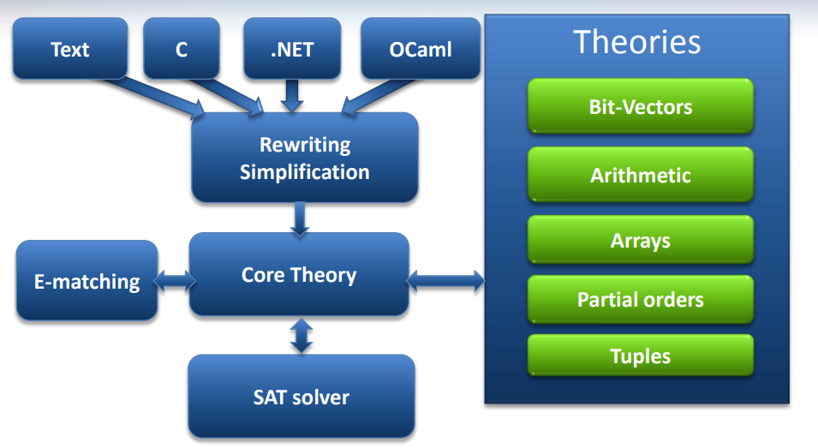
Type-checking is model checking
F*
type checker
Z3 theorem prover
Does type X match type Y?
Is there a counterexample to statement Z?
(assert (not (forall ((@x0 Term) (@x1 Term))
(implies (and (HasType @x0 EvenOdd.odd)
(HasType @x1 EvenOdd.even))
(or label_3
(= (Prims.op_Modulus (Prims.op_Addition @x0 @x1)
(BoxInt 2))
(BoxInt 0))
)
)))

Slide 10
Type-checking is… proof-checking?
We need a couple more pieces:
Dependent types
The horrible pun also known as the Curry-Howard correspondence

Slide 11

The foundational pun (highly fictionalized)
LOGIC: The Hypothetical Syllogism
If A implies B, and B implies C, then A implies C!
(A→ B) → ((B→ C) → (A→ B)

Slide 12

The foundational pun (highly fictionalized)
LOGIC: The Hypothetical Syllogism
If A implies B, and B implies C, then A implies C!
(A→ B) → ((B→ C) → (A→ B)
COMPUTING: Composition
let compose f g x = f (g x))
(A→ B) → ((B→ C) → (A→ B)

Slide 13

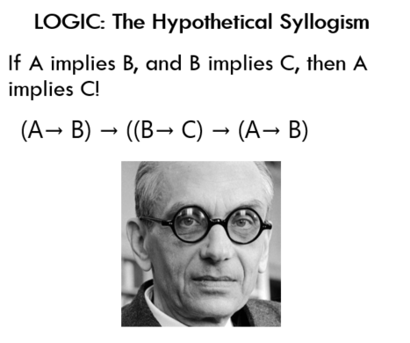
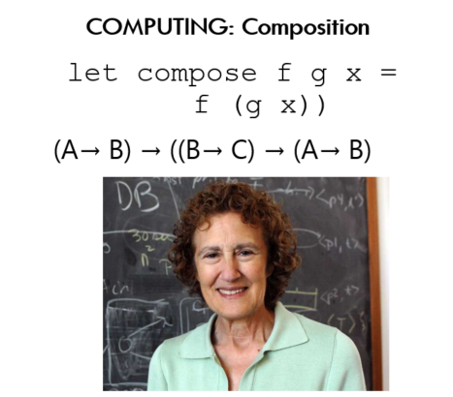
The foundational pun (highly fictionalized)
LOGIC: The Hypothetical Syllogism
If A implies B, and B implies C, then A implies C!
(A→B) → ((B→C) → (A→B)
COMPUTING: Composition
let compose f g x = f (g x))
(A→B) → ((B→C) → (A→B)

Slide 14
This is the hardest part (except for all the other hard parts)
A function is a constructive proof.
Most functions don’t prove very interesting theorems.
let square (x:int) : int = op_Multiply x x
has type
int → int
or, in English, it says
If an integer exists, then an integer exists.
though the form that’s maybe more useful is:
For all integers X, some integer exists.

Slide 15
How do we write a more interesting proof?
By expanding the language of types we can talk about!
Suppose we want to prove
For any prime X, there is some prime Y, and Y is strictly larger than X.
The corresponding theorem in the language of F* is:
val larger_prime : (x:prime) -> (y:prime{y>x})
The refinement now refers to a previous argument; the jargon for this is dependent typing.
Notes:
Types are propositions!
This theorem would be reasonably hard to prove, so I’m not going to.

Slide 16
Dependent Type examples
From the F* standard library:
The index function only takes an index that is provably less than the length of the list!
val index: #a:Type -> l:list a -> i:nat{i < length l} -> Tot a
The filter function returns a list; every member of that list satisfies the predicate given.
val filter : #a: Type -> f:(a -> Tot bool) -> l: list a -> Tot (m:list a{forall x. memP x m ==> f x})

Slide 17
Dependent types: complicated example
let player_1_move (g:game_state{g.turn=1 /\ g.player_1_score<1000}) :
(h:game_state{h.turn = 2 /\ h.num_die_rolls = g.num_die_rolls + 3 /\ h.player_2_score = g.player_2_score /\
h.player_2_position = g.player_2_position}) =
let d0 = g.next_die in
let d1 = advance_die d0 in
let d2 = advance_die d1 in
let next_d = advance_die d2 in
let new_p = advance_position g.player_1_position d0 d1 d2 in
let new_score = g.player_1_score + new_p in
{ g with player_1_score=new_score;
player_1_position=new_p;
turn=2;
next_die=next_d;
num_die_rolls = 3 + g.num_die_rolls }
From Advent Of Code 2021, day 21
type game_state = { player_1_score : (n:nat{n<max_score}); player_1_position : board_position; player_2_score : (n:nat{n<max_score}); player_2_position : board_position; turn : (n:nat{n = 1 \/ n = 2}); // deterministic die cycles // between 1 and 100 next_die : die_value; num_die_rolls: nat }

Slide 18
Sugar for proofs
Sometimes, we only care about the proposition, not the value. Or, we may not be able to fit the whole (checkable) proof in a return value.
F* has the type unit which has only a single element, written ().
You can still refine unit with a dependent type, for example:
unit{a + b = b + a}
So, we can write the commutative property of addition as
val commutes (a:int) -> (b:int) -> unit{a + b = b + a}

Slide 19
Sugar for proofs
val commutes (a:int) -> (b:int) -> unit{a + b = b + a}
The idiomatic way to write this is
val commutes (a:int) (b:int) : Lemma (a + b = b + a)
Or, to prove it, we just have to ask the SMT solver for help; just return unit (because that’s the only value of the return type!)
let commutes (a:int) (b:int) : Lemma (a + b = b + a) = ()
let commutes_alt (a:int) (b:int) : Lemma (requires True) (ensures a + b = b + a) = ()

Slide 20
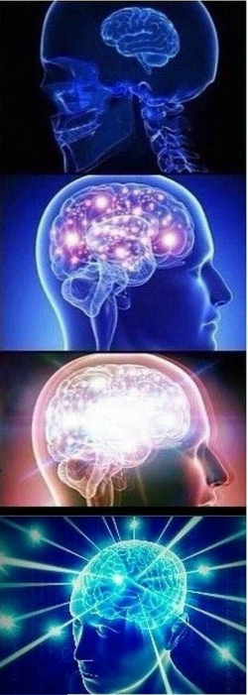
Inductive proofs
Because proofs are “just” functions, we can do all the normal things a functional language provides:
Take them as arguments
Call them when we need their results
Build higher-order proofs
Recursively have the proof call itself (aka, induction!)

Slide 21
Induction
What’s you favorite inductive proof? (Audience participation here!)
Here’s an example from the standard library:
(** [for_all f l] returns [true] if, and only if, for all elements [x]
appearing in [l], [f x] holds.
let rec for_all_mem
(#a: Type)
(f: (a -> Tot bool))
(l: list a)
: Lemma
(for_all f l <==> (forall x . memP x l ==> f x))
= match l with
| [] -> ()
| _ :: q -> for_all_mem f q

Slide 22
But that’s not all!
F* also checks the behavior of a function, its “computation type”, which may include pre- and post-conditions
Tot functions must always terminate and are also Pure, no side effects
GTot (ghost total) functions are total functions that do not compute anything; these are used for Lemma
Dv (divergent) functions are total functions have no side effect
ML functions may do I/O (and also fail to terminate)
Sometimes you have to give a hint to help F* prove that your function terminates; the tutorial covers this.
Notes:
Show example

Slide 23
More
Difference between Boolean operators and Boolean predicates, = vs == vs ===
Reasoning about imperative programs (the State effect)
Universes
Custom effects and Dijkstra monads
Tactics and Metaprogramming: automating proofs and generating code
Low*: a subset of F* (plus libraries) that compiles to C
Steel: a language for concurrent programming built on F*

Slide 24
Why should you care?
You might be a PL geek.
You could benefit from learning about a different approach.
“Proving a program, or even just writing down a specification for it, forces you to think about aspects of your program that you may never have considered before.”
You want to prove something?
Other proof assistants might be more friendly and mature.
You need to write high-assurance software…
Modelling languages like TLA+ or Alloy are probably easier to get started with (but don’t generate code!)
F* is very much a research language.
Maybe investigate Dafny and Liquid Haskell

Slide 25
F* Resources
New tutorial under construction: http://www.fstar-lang.org/tutorial/
Hidden old tutorial which is more complete but less interactive: https://fstar-lang.org/tutorial/tutorial.html
Tactics tutorial: https://people.csail.mit.edu/cpitcla/fstar.js/TacticsTutorial.html
Project Everest Slack (invite-only?)
My Advent-of-Code in F* repository: https://github.com/mgritter/aoc-fstar
I wrote some notes on features missing from the tutorial: https://github.com/mgritter/aoc-fstar/blob/main/doc/FeaturesForTheCompleteNoob.md
Video series on YouTube: https://www.youtube.com/playlist?list=PLVoZsDupSnwHtYDM4VCMG-HD4CGHOoHOP
The Little Typer! (for an introduction to dependent types)

Slide 26


About Me
Currently at Akita Software, working on the completely opposite approach: bottom-up, no-code inference of API behavior.
Previously Vault team at HashiCorp, co-founder Tintri
Get in touch Twitter: markgritter Email: mgritter@gmail.com GitHub: mgritter

Slide 27
Practical F* tips and tricks
When stuck:
Type ascription operator <:
assert() a lot
assume() what you need and come back later (if it works)
Dump out everything F* knows about the current types with one weird trick:
assert_by_tactic True (fun () -> dump "here")
Check you haven’t swapped /\ and \/.
Give S3 more time with –rlimit (sometimes works)
Let F* unroll recursive definitions more with –fuel (hardly ever works)

